Slide 1
Soft Computing
CS3EA03

Slide 2
UNIT- 2
Neural Network Architectures: Supervised Learning: Backpropagation Network architecture, Backpropagation algorithm, Limitation, Characteristics and Application of EBPA, Bidirectional associative memories (BAM), Unsupervised Learning: Hebbian Learning, Generalized Hebbian learning algorithm, Competitive learning, Self- Organizing Computational Maps: Kohonen Network, Applications of ANN to solve real world’s problems.

Slide 3
Introduction to ANN
An Artificial Neural Network (ANN) is an information processing paradigm that is inspired by the brain. ANNs, like people, learn by examples. An ANN is configured for a specific application, such as pattern recognition or data classification, through a learning process. Learning largely involves adjustments to the synaptic connections that exist between the neurons.

Slide 4
Introduction to ANN
The model of Artificial neural network can be specified by three entities:
Interconnections
Activation functions
Learning rules

Slide 5
Interconnections
Interconnection can be defined as the way processing elements (Neuron) in ANN are connected to each other. Hence, the arrangements of these processing elements and geometry of interconnections are very essential in ANN.

Slide 6
Interconnections
Single-layer feed-forward network
Multilayer feed-forward network
Single node with its own feedback
Single-layer recurrent network
Multilayer recurrent network

Slide 7
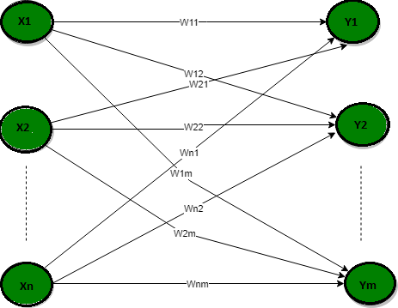
Single-layer feed-forward network

Slide 8
Single-layer feed-forward network
In this type of network, we have only two layers input layer and output layer but the input layer does not count because no computation is performed in this layer. The output layer is formed when different weights are applied on input nodes and the cumulative effect per node is taken. After this, the neurons collectively give the output layer to compute the output signals.

Slide 9
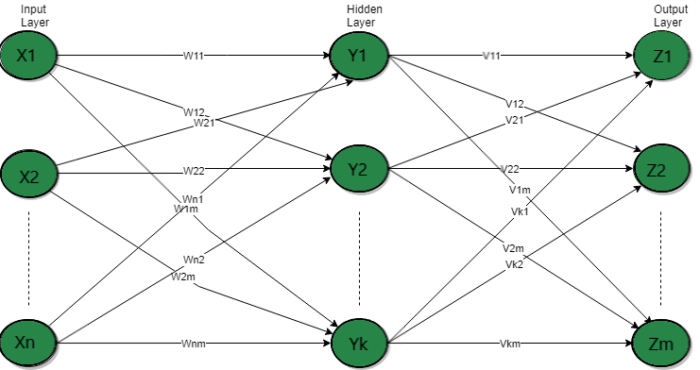
Multilayer feed forward network

Slide 10
Multilayer feed forward network
This layer also has a hidden layer that is internal to the network and has no direct contact with the external layer. The existence of one or more hidden layers enables the network to be computationally stronger, feed-forward network because of information? ows through the input function, and the intermediate computations used to de?ne the output Z. There are no feedback connections in which outputs of the model are fed back into itself.

Slide 11
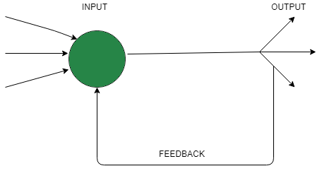
Single node with its own feedback

Slide 12
Single node with its own feedback
When outputs can be directed back as inputs to the same layer or preceding layer nodes, then it results in feedback networks. Recurrent networks are feedback networks with closed loops. The above figure shows a single recurrent network having a single neuron with feedback to itself.

Slide 13
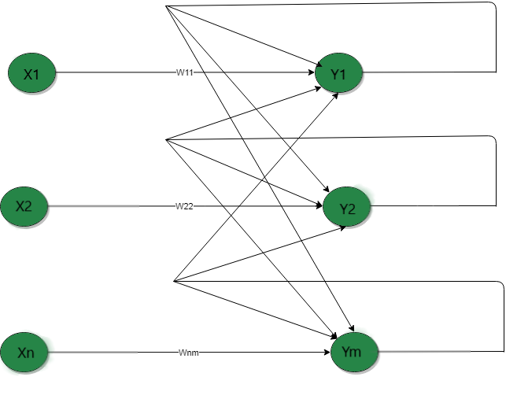
Single-layer recurrent network

Slide 14
Single-layer recurrent network
The above network is a single-layer network with a feedback connection in which the processing element’s output can be directed back to itself or to another processing element or both. A recurrent neural network is a class of artificial neural networks where connections between nodes form a directed graph along a sequence. This allows it to exhibit dynamic temporal behavior for a time sequence. Unlike feedforward neural networks, RNNs can use their internal state (memory) to process sequences of inputs.

Slide 15
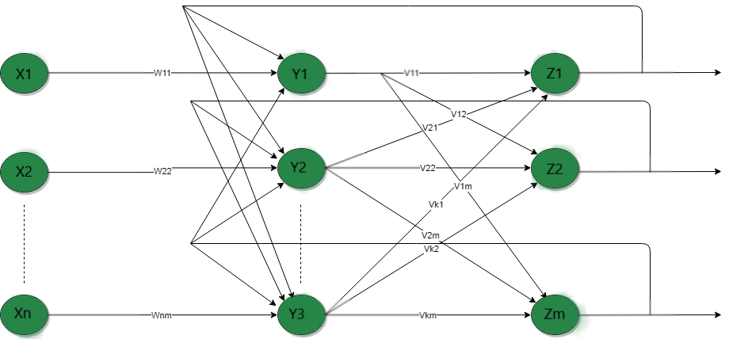
Multilayer recurrent network

Slide 16
Multilayer recurrent network
In this type of network, processing element output can be directed to the processing element in the same layer and in the preceding layer forming a multilayer recurrent network. They perform the same task for every element of a sequence, with the output being dependent on the previous computations. Inputs are not needed at each time step. The main feature of a Recurrent Neural Network is its hidden state, which captures some information about a sequence.

Slide 17
Introduction to ANN
The model of Artificial neural network can be specified by three entities:
Interconnections
Activation functions
Learning rules

Slide 18
Introduction to ANN
The model of Artificial neural network can be specified by three entities:
Interconnections
Activation functions
Learning rules

Slide 19
Learning rule
Learning rule is a method or a mathematical logic. It helps a Neural Network to learn from the existing conditions and improve its performance. It is an iterative process.

Slide 20
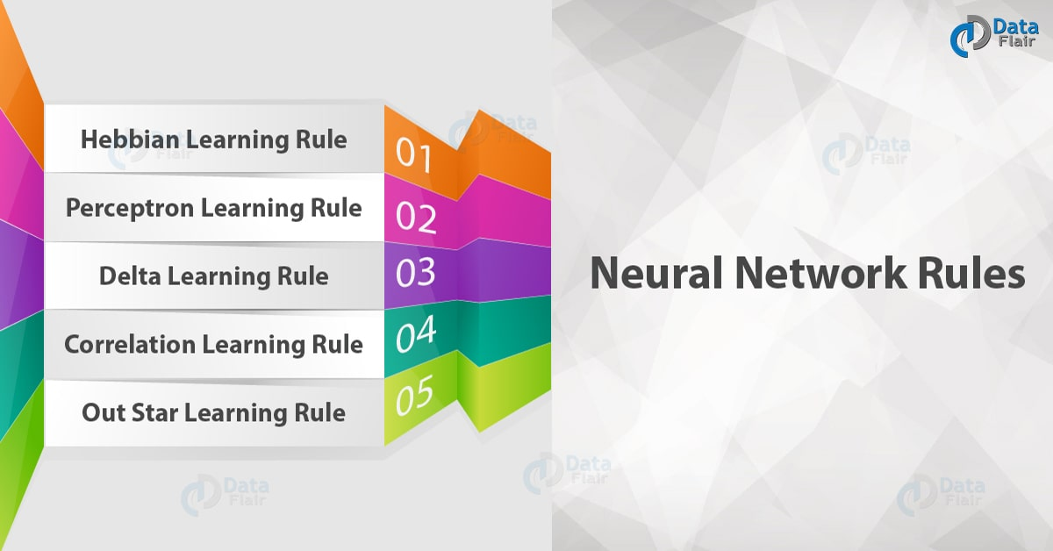

Learning rule

Slide 21
Learning rule
Hebbian learning rule – It identifies, how to modify the weights of nodes of a network.
Perceptron learning rule – Network starts its learning by assigning a random value to each weight.
Delta learning rule – Modification in sympatric weight of a node is equal to the multiplication of error and the input.
Correlation learning rule – The correlation rule is the supervised learning.
Outstar learning rule – We can use it when it assumes that nodes or neurons in a network arranged in a layer.

Slide 22
Types of learning
SUPERVISED LEARNING
2. UNSUPERVISED LEARNING
3. REINFORCEMENT LEARNING

Slide 23
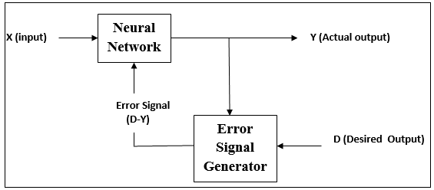
TYPES OF LEARNING
Supervised Learning---The learning algorithm would fall under this category if the desired output for the network is also provided with the input while training the network. By providing the neural network with both an input and output pair it is possible to calculate an error based on it's target output and actual output. It can then use that error to make corrections to the network by updating it's weights.

Slide 24
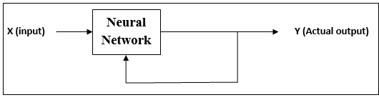
TYPES OF LEARNING
Unsupervised Learning---In this paradigm the neural network is only given a set of inputs and it's the neural network's responsibility to find some kind of pattern within the inputs provided without any external aid. This type of learning paradigm is often used in data mining and is also used by many recommendation algorithms due to their ability to predict a user's preferences based on the preferences of other similar users it has grouped together.

Slide 25
TYPES OF LEARNING
Reinforcement Learning---Reinforcement learning is similar to supervised learning in that some feedback is given, however instead of providing a target output a reward is given based on how well the system performed. The aim of reinforcement learning is to maximize the reward the system receives through trial-and-error. This paradigm relates strongly with how learning works in nature, for example an animal might remember the actions it's previously taken which helped it to find food (the reward).

Slide 26
BACKPROPAGATION NETWORK
A single-layer neural network has many restrictions. This network can accomplish very limited classes of tasks. Minsky and Papert (1969) showed that a two layer feed-forward network can overcome many restrictions, but they did not present a solution to the problem as "how to adjust the weights from input to hidden layer" ?
An answer to this question was presented by Rumelhart, Hinton and Williams in 1986. The central idea behind this solution is that the errors for the units of the hidden layer are determined by back-propagating the errors of the units of the output layer. This method is often called the Back-propagation learning rule.
Back-propagation is a systematic method of training multi-layer artificial neural networks.

Slide 27
Characteristics of bpn
The main features of Backpropagation are the Iterative, recursive and efficient method through which it calculates the updated weight to improve the network until it is not able to perform the task for which it is being trained. Derivatives of the activation function to be known at network design time is required to Backpropagation.

Slide 28
Characteristics of bpn
Backpropagation is fast, simple and easy to implement.
There are no parameters to be tuned
Prior knowledge about the network is not needed thus becoming a flexible method
This approach works very well in most cases
The model need not learn the features of the function

Slide 29
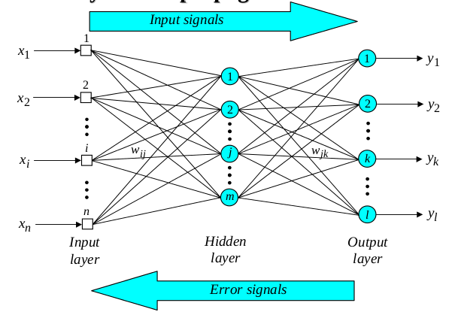
THREE LAYER BACKPROPAGATION NEURAL NETWORK

Slide 30
TRAINING OF BACKPROPAGATION NEURAL NETWORK
Feedforward training of input patterns
– each input node receives a signal, which is broadcast to all
of the hidden units
– each hidden unit computes its activation which is broadcast
to all output nodes
Back propagation of errors
– each output node compares its activation with the desired
output
– based on these differences, the error is propagated back to
all previous nodes Delta Rule
Adjustment of weights
– weights of all links computed simultaneously based on the
errors that were propagated back

Slide 31
TRAINING OF BACKPROPAGATION NEURAL NETWORK
Feedforward Stage
1. Initialize weights with small, random values
2.While stopping condition is not true
– for each training pair (input/output):
• each input unit broadcasts its value to all hidden units
• each hidden unit sums its input signals & applies activation function to compute its output signal
• each hidden unit sends its signal to the output units
• each output unit sums its input signals & applies its activation function to compute its output signal

Slide 32
TRAINING OF BACKPROPAGATION NEURAL NETWORK
Backpropagation stage
3. Each output computes its error term, its own weight correction term and its bias(threshold) correction term & sends it to layer below.
4. Each hidden unit sums its delta inputs from above & multiplies by the derivative of its activation function; it also computes its own weight correction term and its bias correction term.

Slide 33
TRAINING OF BACKPROPAGATION NEURAL NETWORK
Adjusting the Weights
5. Each output unit updates its weights and bias.
6. Each hidden unit updates its weights and bias
--Each training cycle is called an epoch. The weights are updated in each cycle.
--It is not analytically possible to determine where the global minimum is. Eventually the algorithm stops in a low point, which may just be a local minimum.

Slide 34
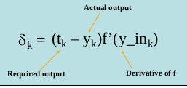
BACKPROPAGATION TRAINING ALGORITHM
Training Algorithm 1
• Step 0: Initialize the weights to small random values
• Step 1: Feed the training sample through the network and determine the final output
• Step 2: Compute the error for each output unit,for unit k it is:

Slide 35
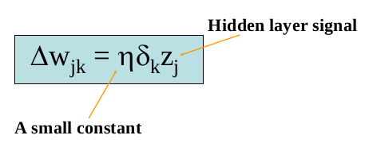
BACKPROPAGATION TRAINING ALGORITHM
Training Algorithm 2
• Step 3: Calculate the weight correction term for each output unit, for unit k it is:

Slide 36
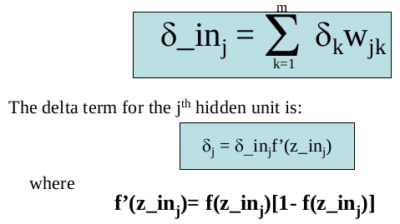
BACKPROPAGATION TRAINING ALGORITHM
Training Algorithm 3
• Step 4: Propagate the delta terms (errors) back through the weights of the hidden units where the delta input for the j th
hidden unit is:

Slide 37
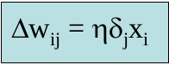
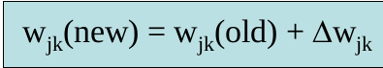
BACKPROPAGATION TRAINING ALGORITHM
Training Algorithm 4
Step 5: Calculate the weight correction term for
the hidden units:
• Step 6: Update the weights:
• Step 7: Test for stopping (maximum cylces,
small changes, etc)

Slide 38
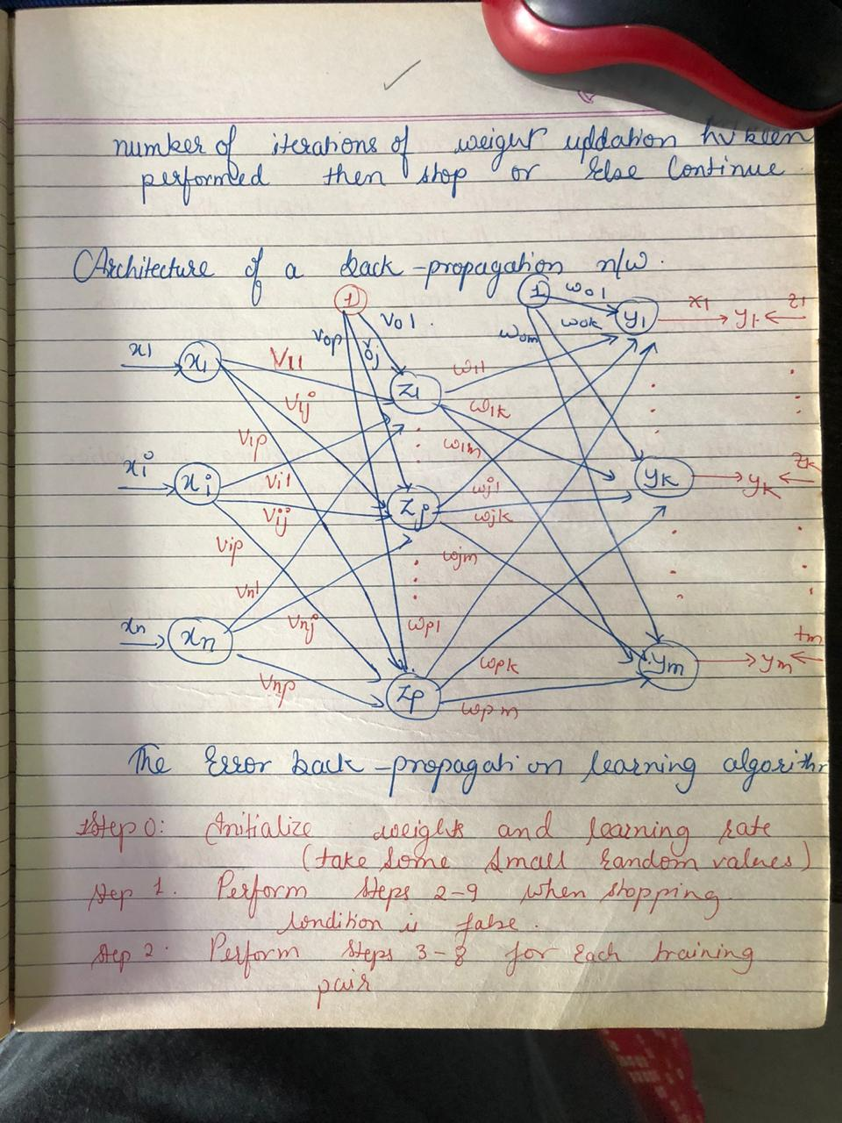

Slide 39
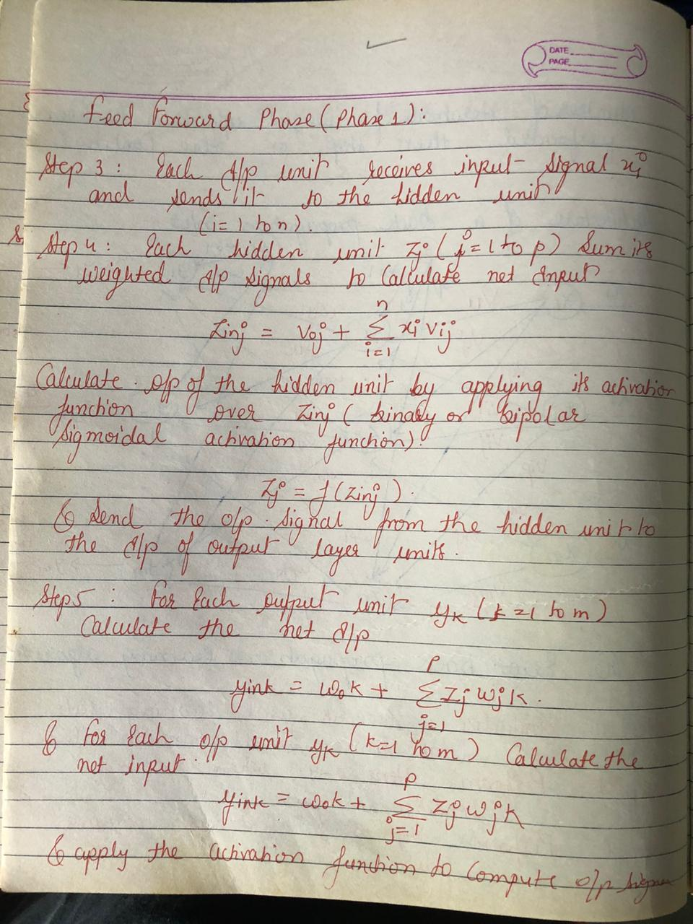

Slide 40
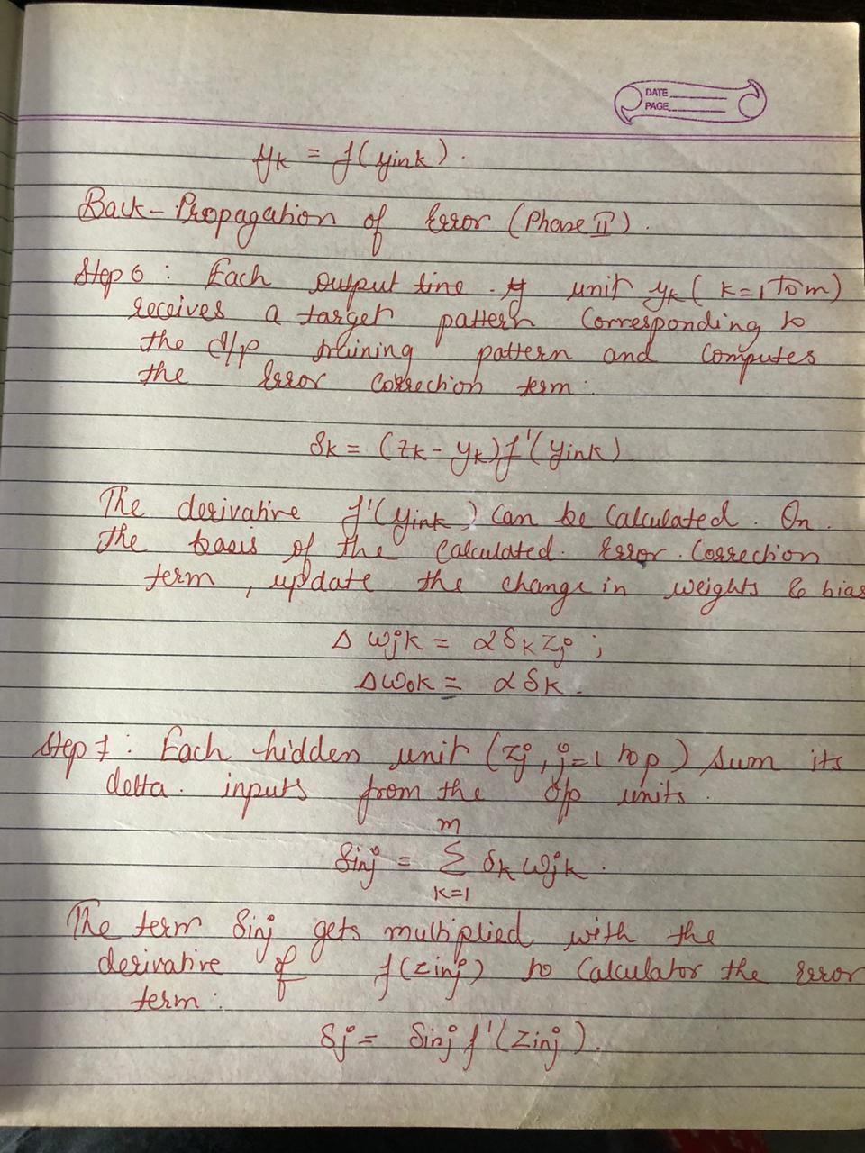

Slide 41
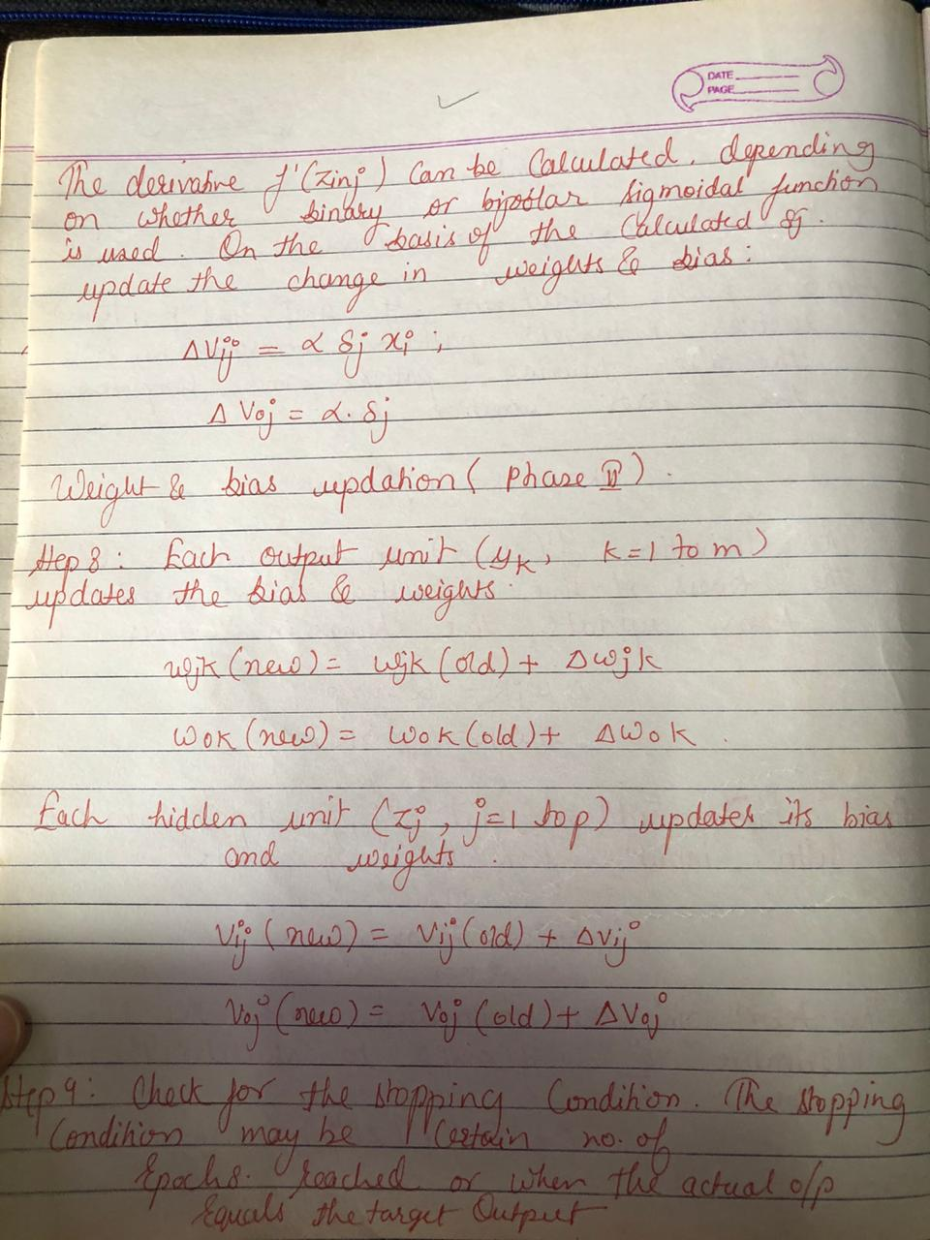

Slide 42
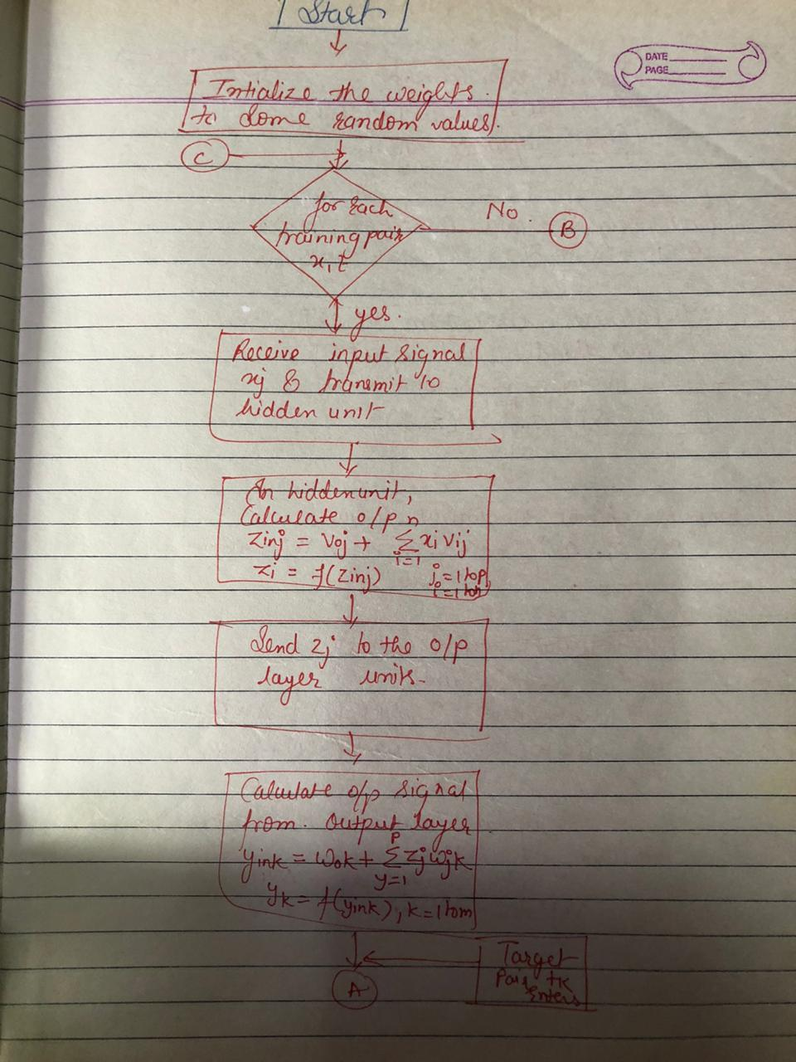
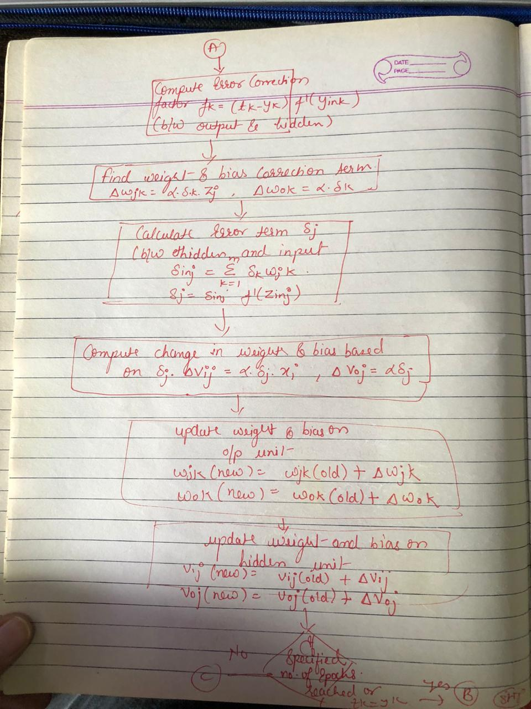

Slide 43
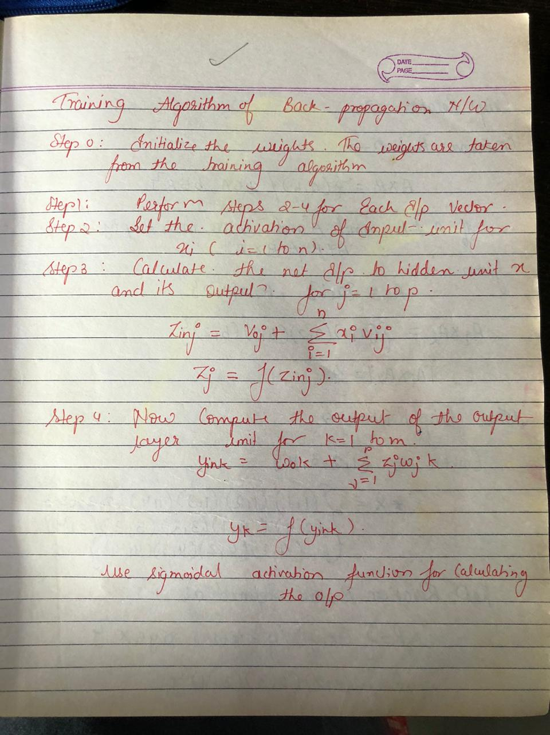

Slide 44
Ebpa /ebpn/bpn/bpa limitations
It relies on input to perform on a specific problem.
Sensitive to complex/noisy data.
It needs the derivatives of activation functions for the network design time.

Slide 45
Ebpa applications
The neural network is trained to enunciate each letter of a word and a sentence
It is used in the field of speech recognition
It is used in the field of character and face recognition

Slide 46
Ebpa applications
The neural network is trained to enunciate each letter of a word and a sentence
It is used in the field of speech recognition
It is used in the field of character and face recognition

Slide 47
Ebpa applications
The neural network is trained to enunciate each letter of a word and a sentence
It is used in the field of speech recognition
It is used in the field of character and face recognition

Slide 48
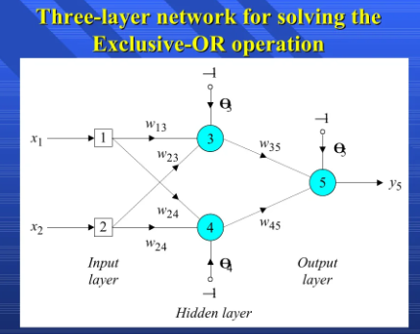

Slide 49
Associative memory network
It can store a set of patterns as memories.
When the associative memory is being presented with a key pattern, it responds by producing one of the stored patterns, which closely resembles or related to the key pattern.
Is also known as content addressable memories(CAM).

Slide 50
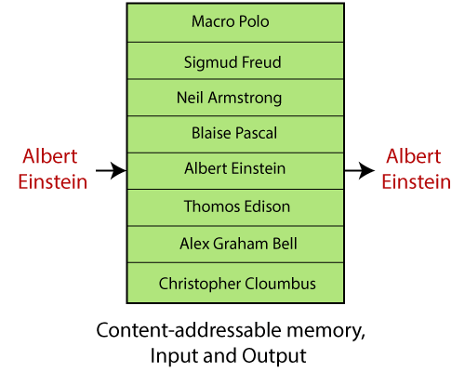
Associative memory network

Slide 51
Associative memory network
TYPES:-
Auto Associative Memory
Hetero Associative Memory
Both these are single layer nets in which the weights are determined in a manner that the net stores a set of pattern associations.

Slide 52
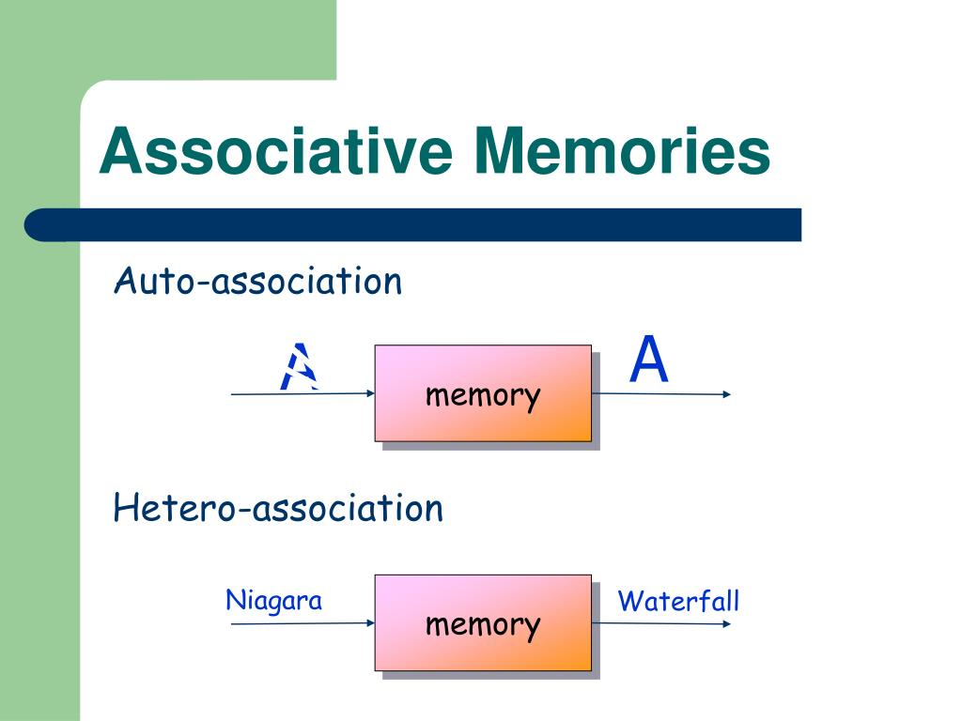
Associative memory network
Input output vector pair, say S:T
AAM- S:T(similar)
HAM- S:T(not similar)

Slide 53
Bidirectional associative memory
Bidirectional Associative Memory (BAM) was developed by Kosko in 1988, is a supervised learning model. This is hetero-associative memory, for an input pattern, it returns another pattern which is potentially of a different size. This phenomenon is very similar to the human brain. Human memory is necessarily associative. It uses a chain of mental associations to recover a lost memory like associations of faces with names, in exam questions with answers, etc.

Slide 54
Why BAM is required?
The main objective to introduce such a network model is to store hetero-associative pattern pairs. This is used to retrieve a pattern given a noisy or incomplete pattern.
It performs forward and backward associative searches for stored stimulus responses.
It encodes binary or bipolar patterns using Heb learning rule.

Slide 55
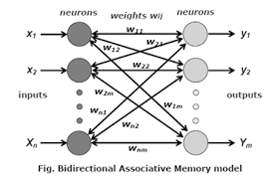
BAM Architecture:
When BAM accepts an input of n-dimensional vector X from set A then the model recalls m-dimensional vector Y from set B. Similarly when Y is treated as input, the BAM recalls X.

Slide 56
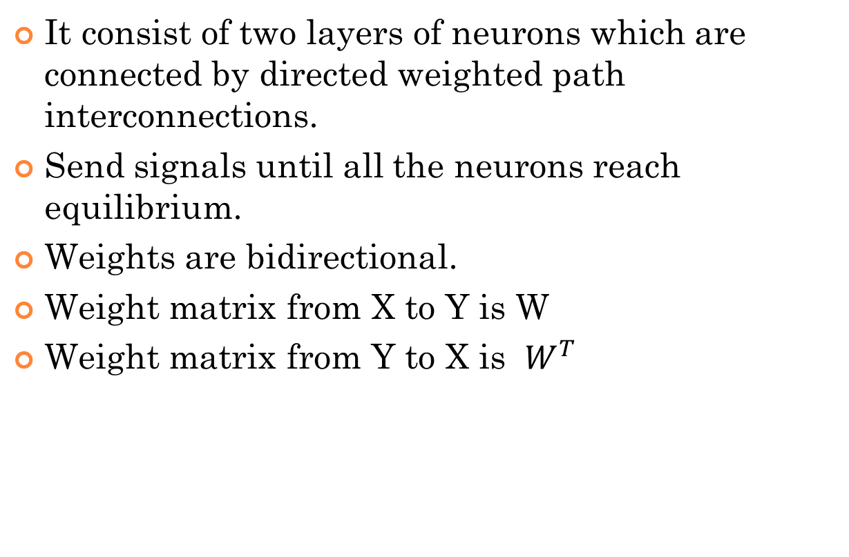
architecture
It consist of two layers of neurons which are connected by directed weighted path interconnections.
Send signals until all the neurons reach equilibrium.
Weights are bidirectional.
Weight matrix from X to Y is W
Weight matrix from Y to X is $W^{T}$

Slide 57
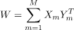
Algorithm:
Storage (Learning): In this learning step of BAM, weight matrix is calculated between M pairs of patterns (fundamental memories) are stored in the synaptic weights of the network following the equation

Slide 58
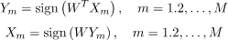
Algorithm:
Testing: We have to check that the BAM recalls perfectly for corresponding and recalls for corresponding . Using,

Slide 59
Algorithm:

Slide 60
BAM TYPES
Discrete bidirectional associative memory
Continuous bidirectional associative memory

Slide 62
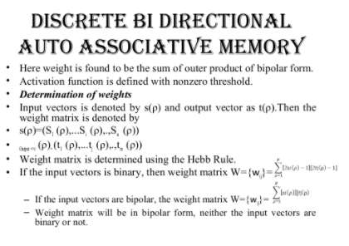

Slide 63
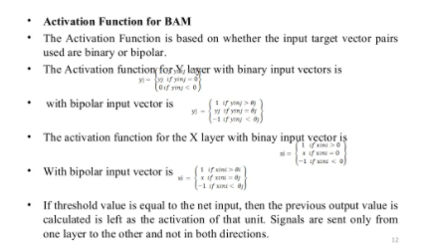
Concept of computing :

Slide 64
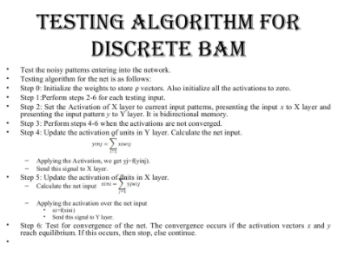
Types of computing

Slide 65
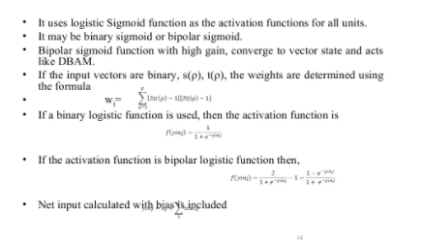
Hard computing

Slide 66
Hebb Learning Rule
Donald Hebb stated in 1949 that “ In brain, the learning is performed by the change in the synaptic gap”.
It is one of the first and also easiest learning rules in the neural network. It is used for pattern classification.
It is a single layer neural network, i.e. it has one input layer and one output layer. The input layer can have many units, say n. The output layer only has one unit. Hebbian rule works by updating the weights between neurons in the neural network for each training sample.

Slide 67
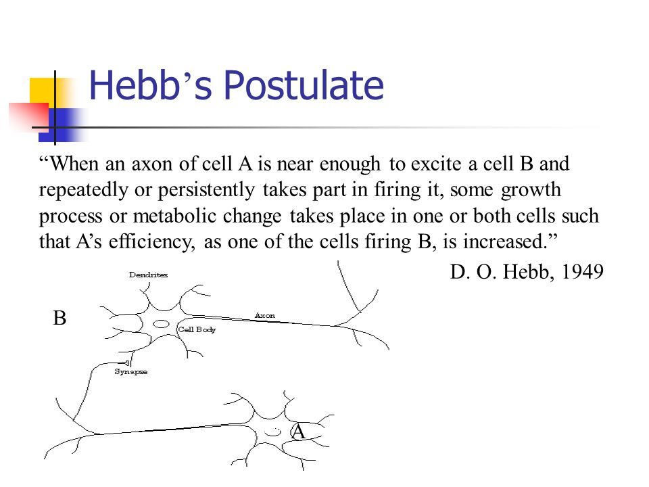

Slide 68
Hebb Learning Rule
Donald Hebb stated in 1949 that “ In brain, the learning is performed by the change in the synaptic gap”.
When an axon of cell A is near enough to excite cell B, and repeatedly or permanently takes place in firing it, some growth process or metabolic change takes place in one or both the cells such than A’s efficiency, as one of the cells firing B, is increased.
According to Hebb rule, the weight vector is found to increase proportionately to the product of the input and the learning signal.

Slide 69
Hebb Learning Rule
In Hebb learning, two interconnected neurons are ‘on’ simultaneously. The weight update in Hebb rule is given by
W_{i}(new) = w_{i} (old)+ x_{i} y.
Bi(new)=bi(old) +y
It is suited more for bipolar data.
If binary data is used, the weight updating formula cannot distinguish two conditions namely
A training pair in which an input unit is “on” and the target value is “off” A training pair in which both the input unit and the target value is “off”.

Slide 70
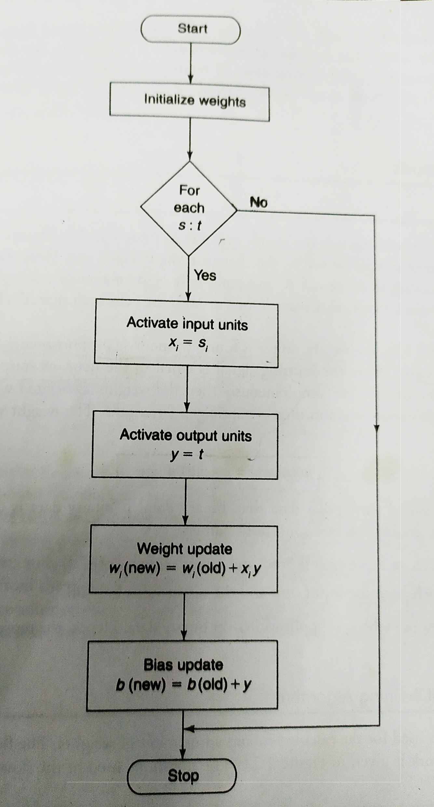

Slide 71
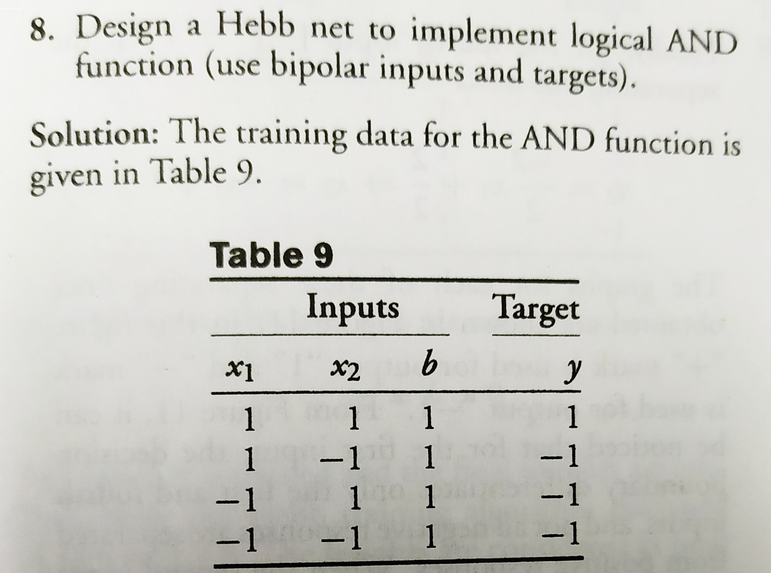

Slide 72
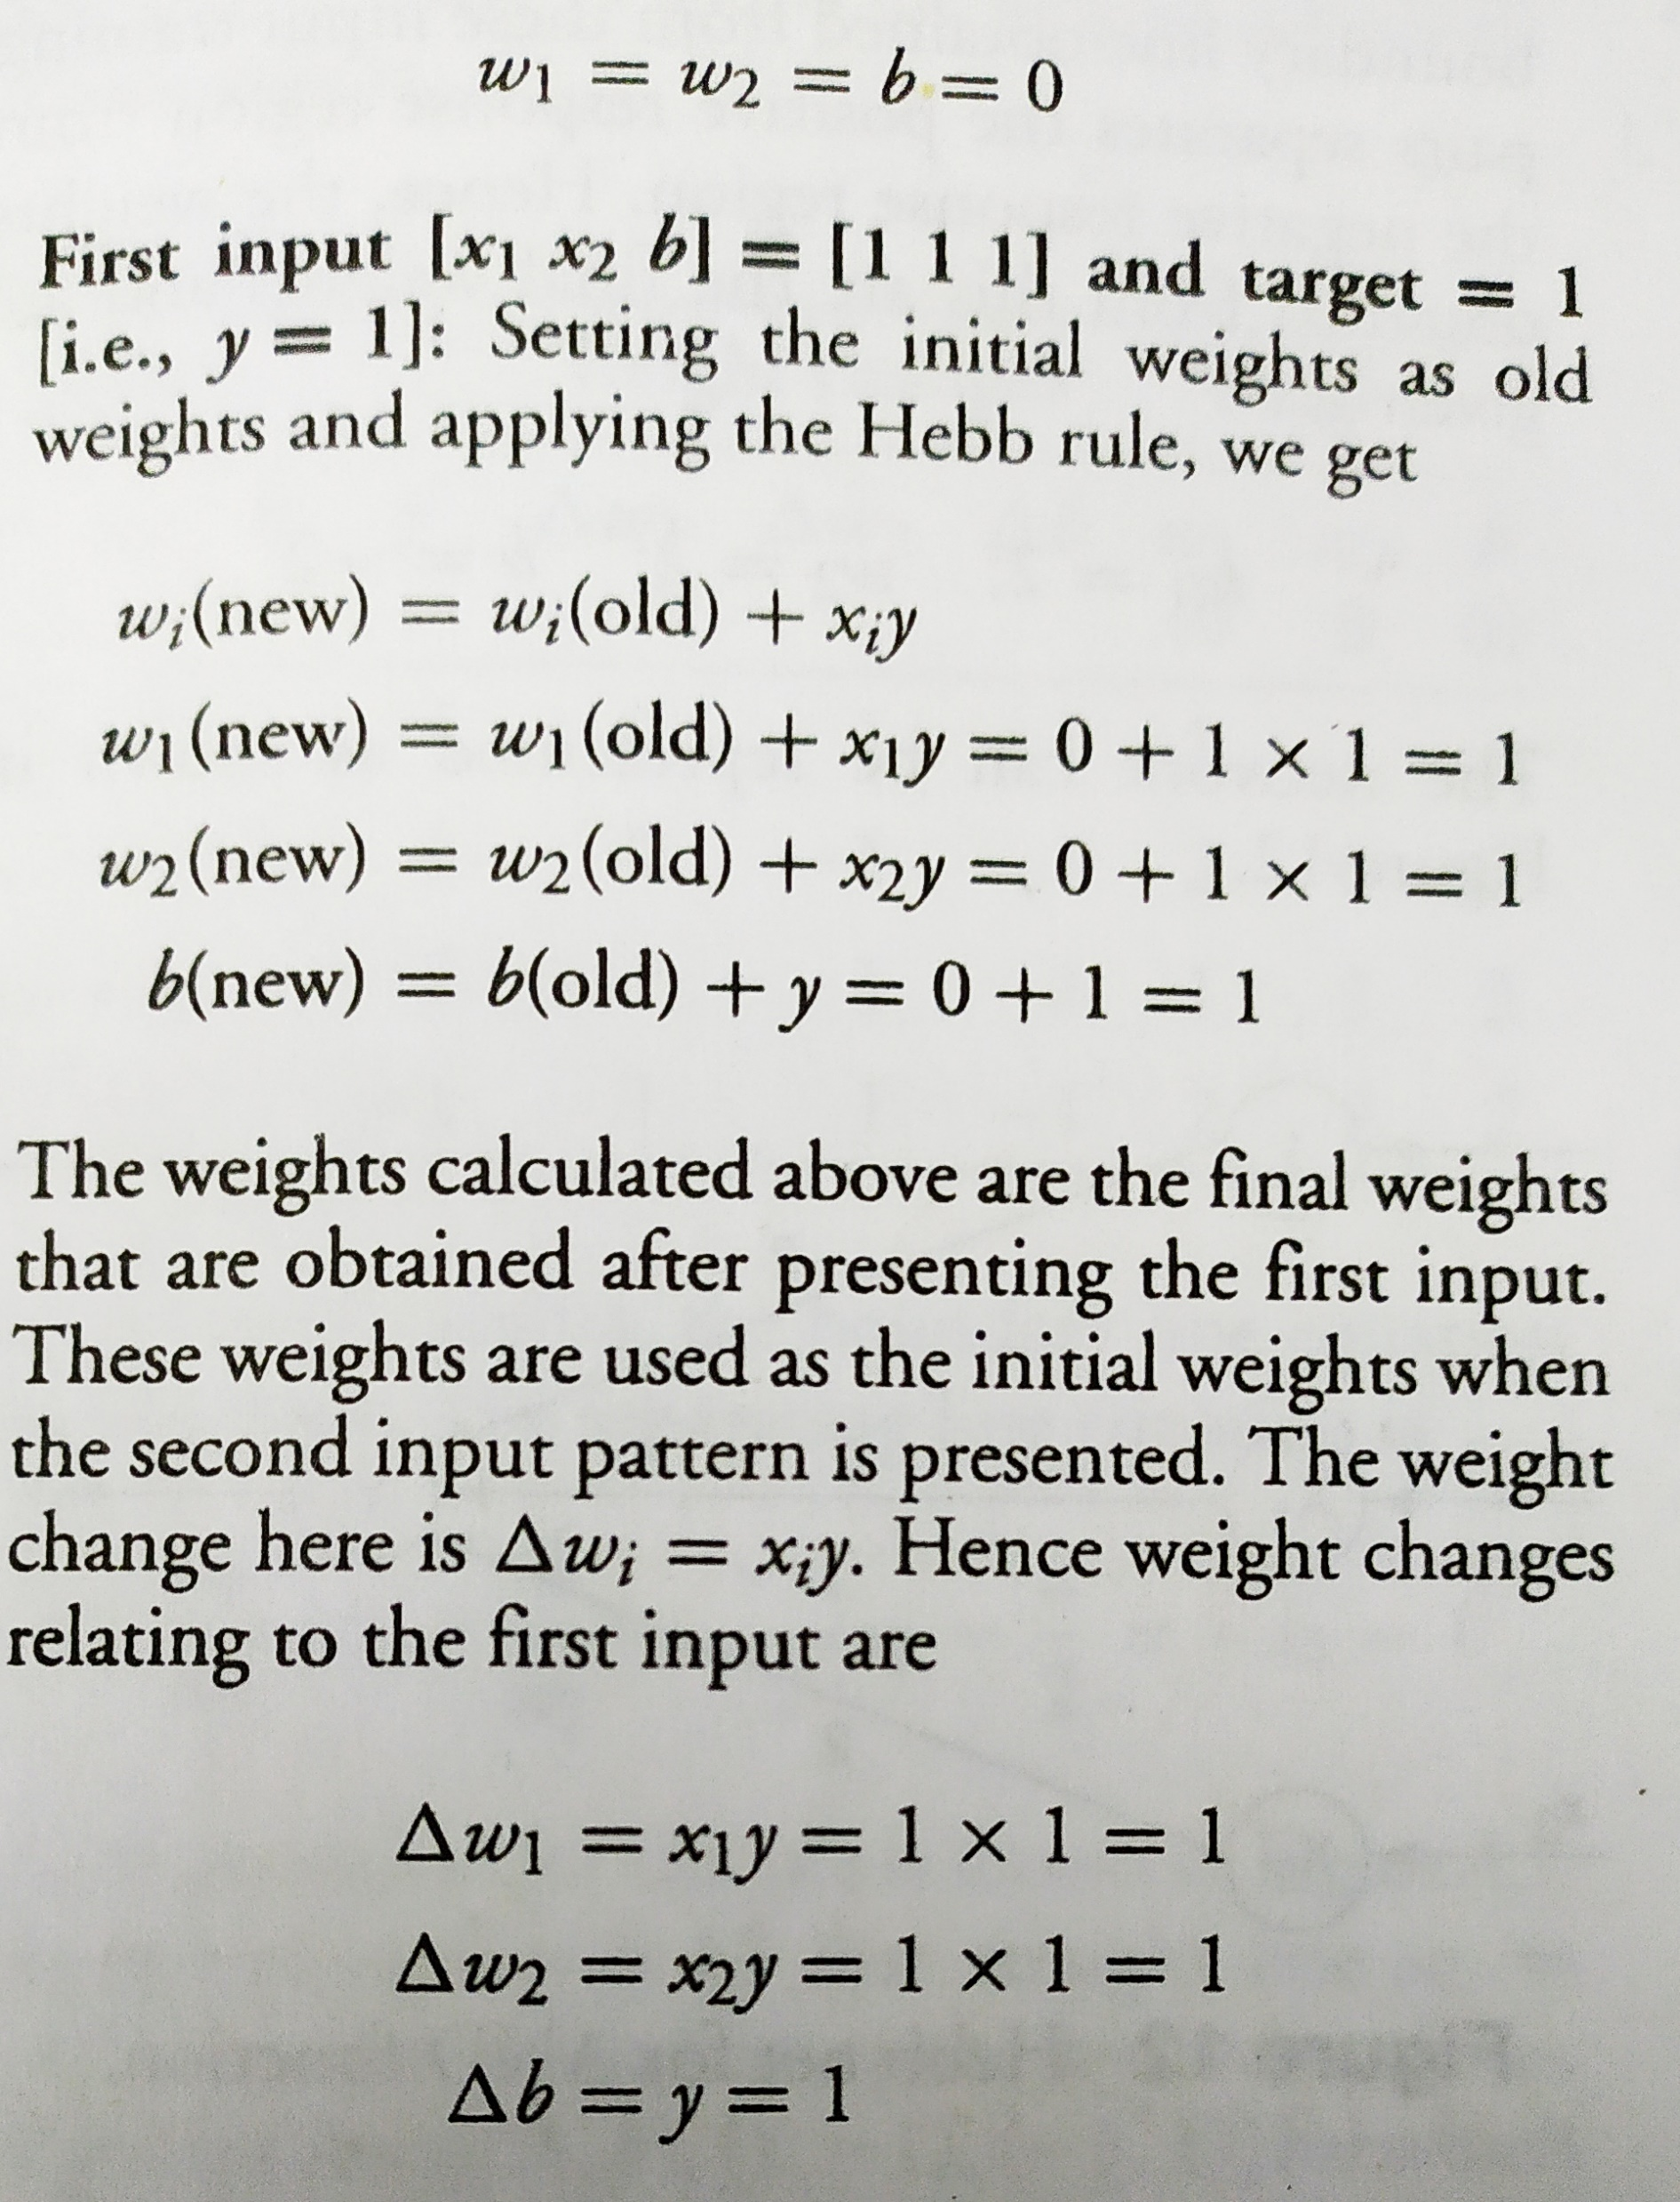

Slide 73
FOR II input X1= 1, X2=-1, B=1, Y= -1
W1(NEW) =W1(OLD)+X1Y
=1+1*(-1)
= 1-1
=0
W2(NEW) =W2(OLD)+X2Y
= 1+(-1*-1)
=1+1
=== =2
B(NEW) = B(OLD)+Y
=1+(-1)
=1-1
= 0
New weights and bias are w1=0, w2=2 and b=0

Slide 74
Weight change
Del w1= x1y
=1*(-1)
-1
Del w2 = x2y
= -1*-1
1
Del b = y
=-1

Slide 75
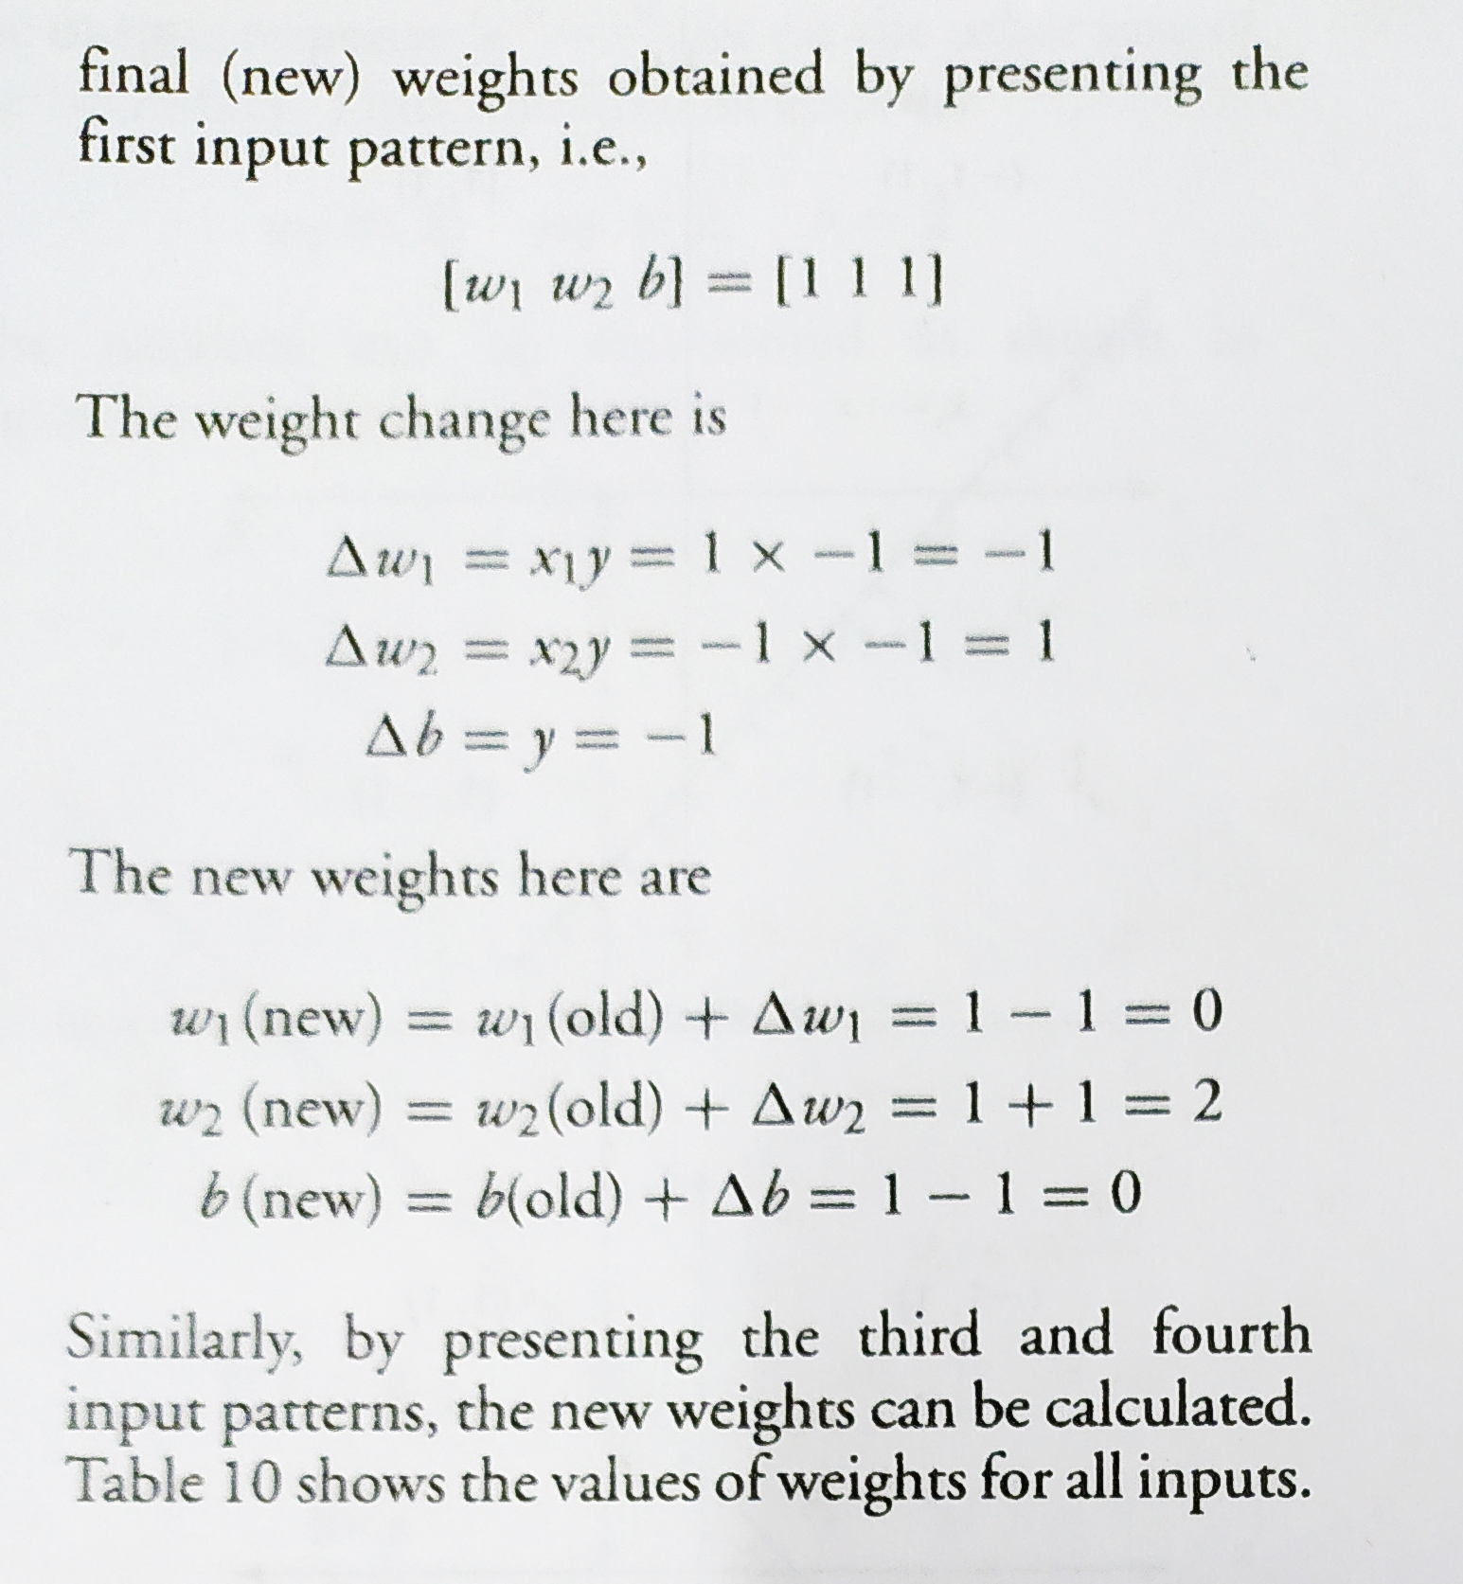

Slide 76
FOR III input X1= -1, X2=1, B=1, Y= -1 weights and bias are w1=0, w2=2 and b=0
W1(NEW) =W1(OLD)+X1Y
=0+(-1*(-1))
= 0+1
=1
W2(NEW) =W2(OLD)+X2Y
= 2+(1*-1)
=2-1
=== =1
B(NEW) = B(OLD)+Y
=0+(-1)
=0-1
= -1
New weights and bias are w1=1, w2=1 and b=-1

Slide 77
Weight change X1= -1, X2=1, B=1, Y= -1
Del w1= x1y
=-1*(-1)
= 1
Del w2 = x2y
= 1*-1
-1
Del b = y
=-1

Slide 78
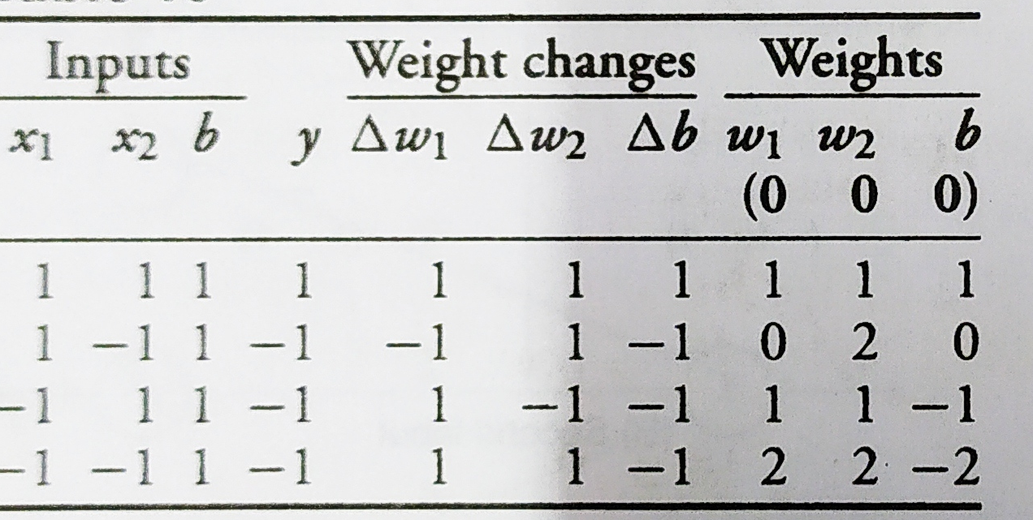

Slide 79
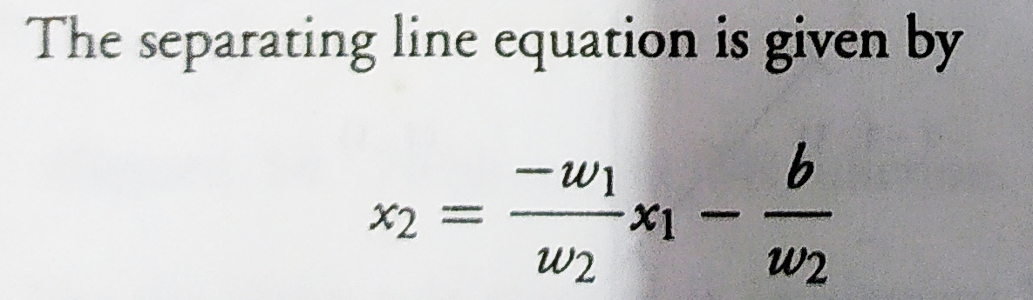

Slide 80
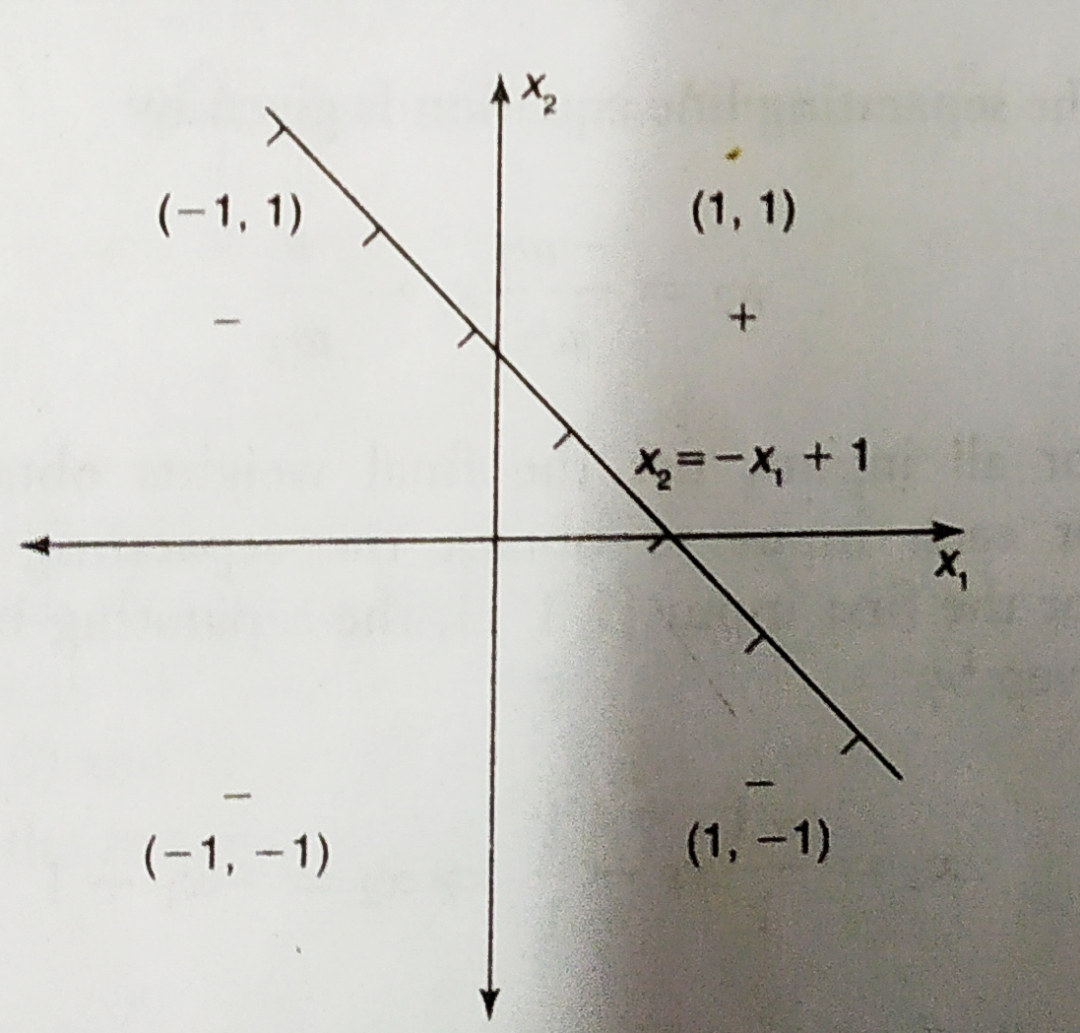

Slide 81
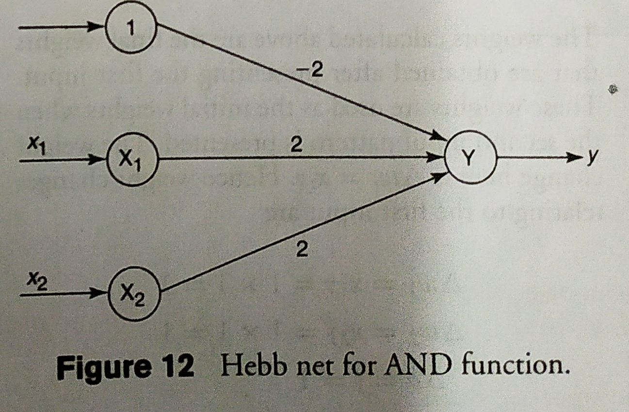

Slide 82
Competitive Learning in ANN
It is concerned with unsupervised training in which the output nodes try to compete with each other to represent the input pattern.

Slide 83
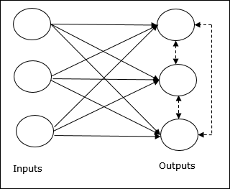
Basic Concept of Competitive Network
This network is just like a single layer feed-forward network having feedback connection between the outputs. The connections between the outputs are inhibitory type, which is shown by dotted lines, which means the competitors never support themselves.

Slide 84
Competitive Learning in ANN
There would be competition among the output nodes so the main concept is - during training, the output unit that has the highest activation to a given input pattern, will be declared the winner. This rule is also called Winner-takes-all because only the winning neuron is updated and the rest of the neurons are left unchanged.

Slide 87
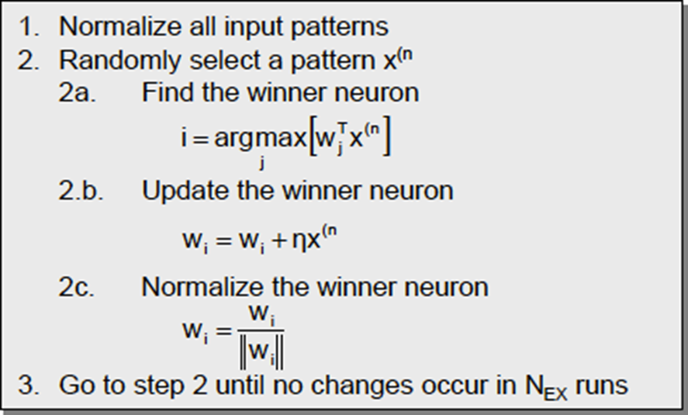
Competitive Learning in ANN

Slide 88
Self- Organizing Computational Maps
It is concerned with unsupervised training in which the output nodes try to compete with each other to represent the input pattern.

Slide 89
Competitive Learning in ANN

Slide 90
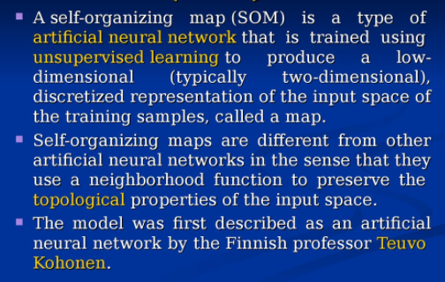

Slide 91
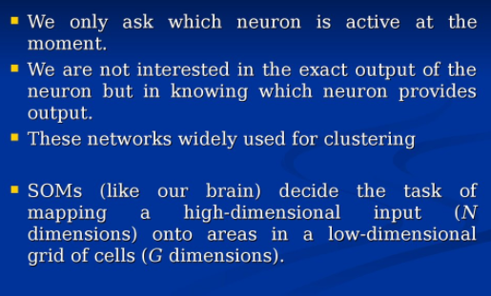

Slide 92
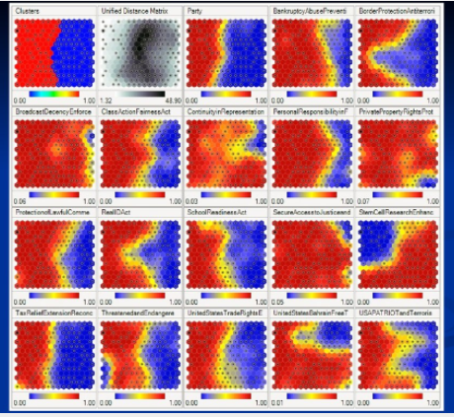

Slide 93
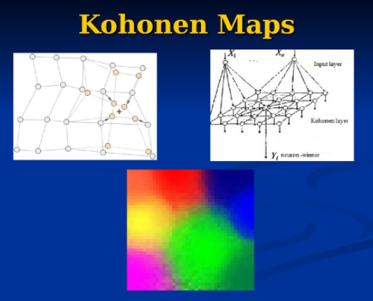

Slide 94
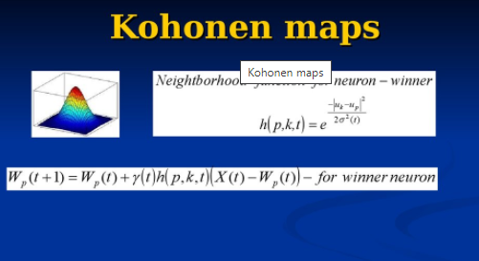

Slide 95
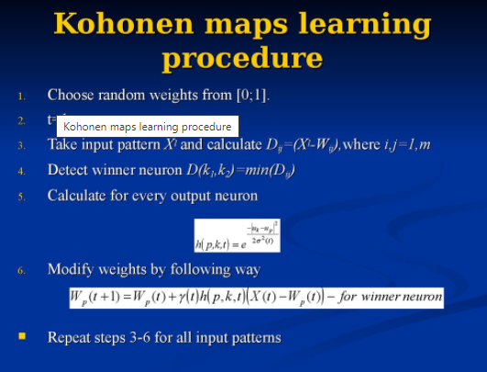

Slide 96
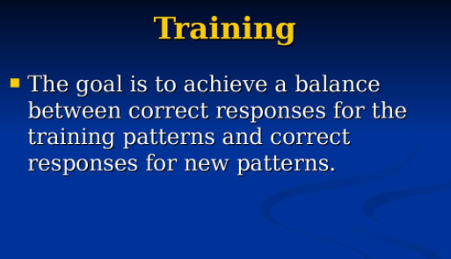

Slide 97


Slide 98


